Slide 1

Team Members: Joemar Mark Syed Tarun
Project Supervisor: Professor SK MD Mizanur Rahman
Cybersecurity – SEC(002)
Detection and Response: Enhancing Intrusion Detection Systems

Slide 2

Agenda
Introduction
Propose and Approach
Data collection
Experimental Setup
Data Preprocessing
Feature Selection
Feature Scaling
Model training
Performance analysis
Conclusion

Slide 3


Introduction
Brute Force Attacks: Systematic trial of all possible character combinations to gain unauthorized access.
Increasing difficulty in detection due to high-speed networks and encryption adoption.
Signs of Brute Force Attacks
Numerous failed login attempts from the same IP.
Login attempts using multiple usernames from the same IP.
Logins from multiple IPs for a single account.
Current Detection Methods
Traditional data models and tools like SSH tunneling and firewalls.
Role of Machine Learning
Potential of ML techniques in network security.
More dynamic and efficient detection mechanisms.

Slide 4

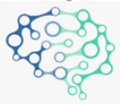
Propose and Approach
CSE-CIC IDS 2018 dataset
Custom
Generated Dataset
Data Preprocessing
Handling missing values
Dropping duplicate rows
Dropping categorical columns
Dropping null values and zero columns
Data Collection (Step-1)
Data Preprocessing (Step-2)
Feature Scaling (Step-3)
Feature Selection (Step-4)
Model Training (Step-5)
Performance Analysis (Step-6)
Feature scaling
Normalization
Label encoding
Feature Selection using Random Forest
ML Models
Decision Trees
Random Forest
MLP (Neural Networks)
KNN
Naïve Bayes
Train models
Test models
Performance Analysis

Slide 5
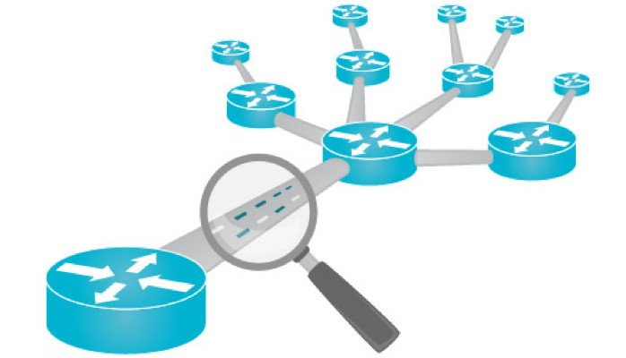
Data Collection
The study replicated the CIC-IDS 2018 benchmark dataset, which comprises real-time network traffic data encompassing both benign and malicious activities.
Employing our custom setup for data collection, ensuring precise and relevant datasets for analysis and evaluation
The datasets were generated using CICFlowMeter and contains 83 features, including both forward and backward directions of network flow and packets.

Slide 6
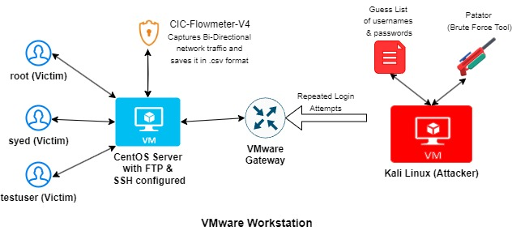
Experimental Setup

Slide 7
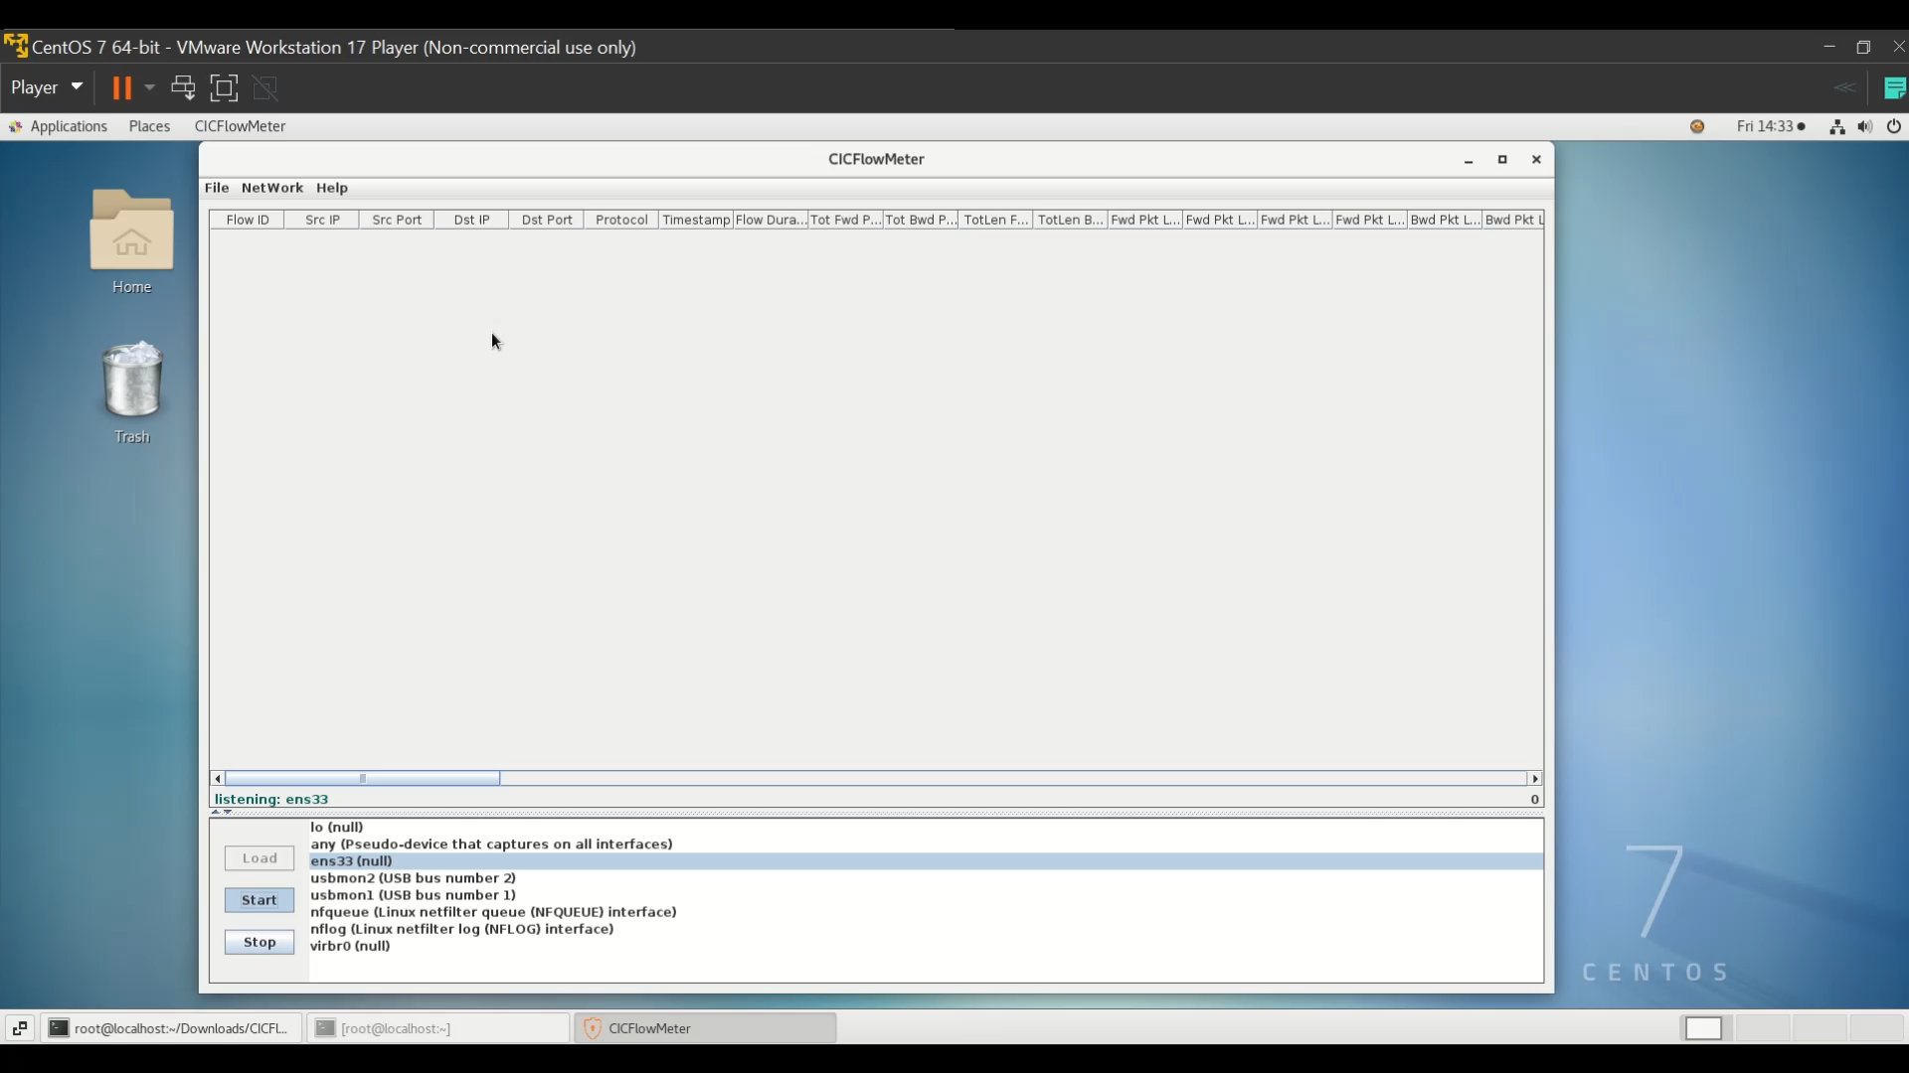

Slide 8
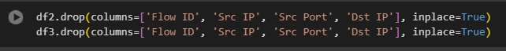
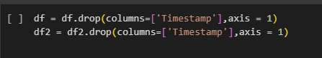
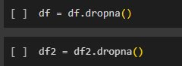
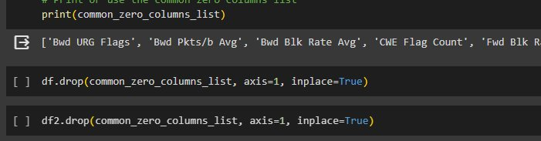
Data Preprocessing
Handling Missing Values:
Identify and address missing data points in the dataset.
Dropping Categorical Columns:
Categorical variables can be converted into numerical equivalents through encoding techniques if needed.
Removing Zero Columns:
Helps reduce noise and improve computational efficiency.
Dropping Duplicate and Null Rows:
Eliminate rows with null or empty values to maintain data integrity and accuracy.
Purpose:
Enhance data quality and reliability for subsequent analysis.
Ensure the dataset is well-prepared and suitable for machine learning algorithms and statistical modeling.
Dropping categorical Columns
Dropping missing values
Dropping zero columns

Slide 9

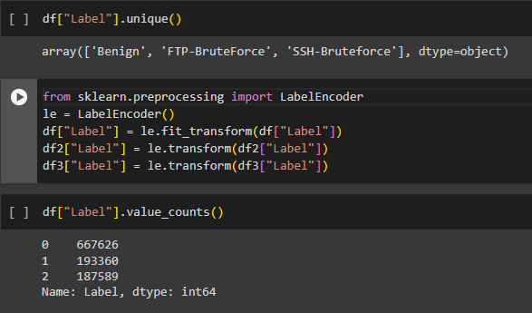
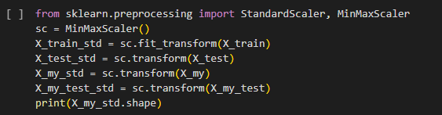
Feature Scaling
Normalization of Input Features:
Scale input features to a common range, often between 0 and 1.
Ensures uniformity in feature magnitudes, preventing dominance by larger values and improving algorithm convergence.
Label Encoding of Output Features:
Encode categorical or textual output labels into numerical representations.
Purpose:
Facilitate consistent data representation across features, aiding ML algorithms' performance.
Prevent biases or inaccuracies caused by feature magnitude variations.
Label Encoding
Normalizing Datasets

Slide 10

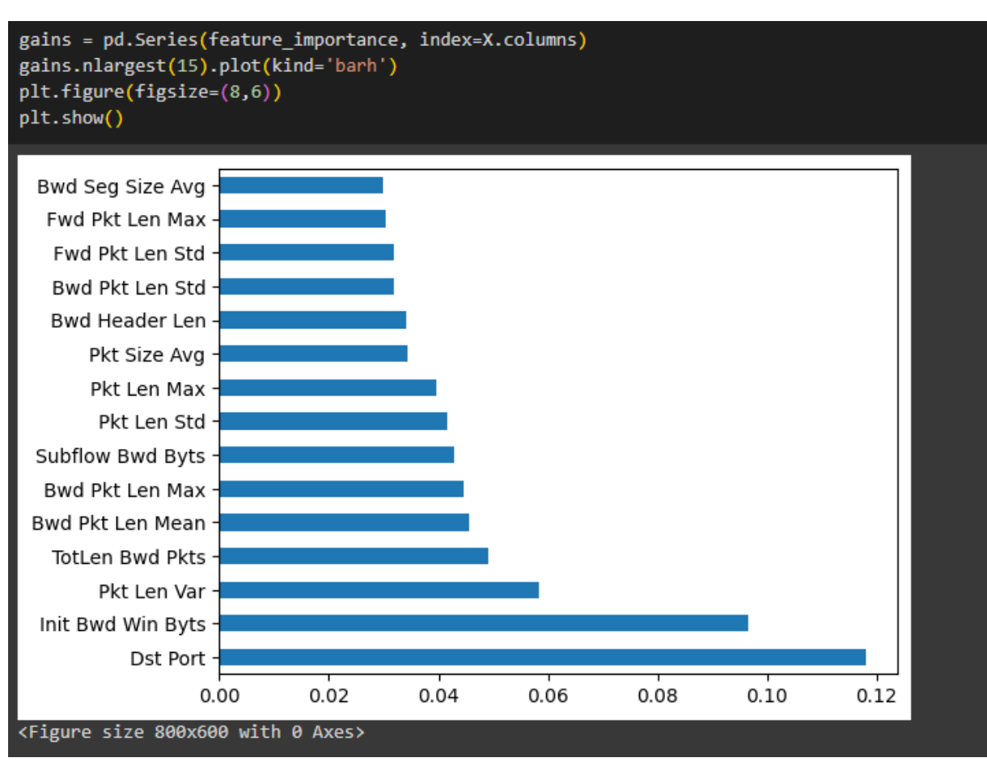
Feature Selection
Feature Importance Evaluation:
Features with higher importance scores are considered more influential in making predictions, while less important features are pruned.
Purpose:
Enhance model's predictive power by focusing on influential features and reducing noise.

Slide 11
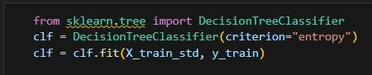
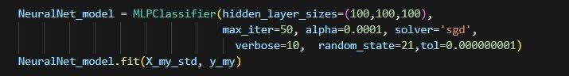
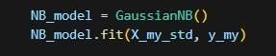
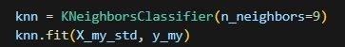
Model Training
Decision Tree
Purpose:
Explore different learning approaches to find the most accurate and efficient model for the given dataset.
Understand the strengths and limitations of each algorithm to choose the most appropriate for the problem at hand.
Random Forest
MLP (Neural networks)
Naïve Bayes
KNN

Slide 12
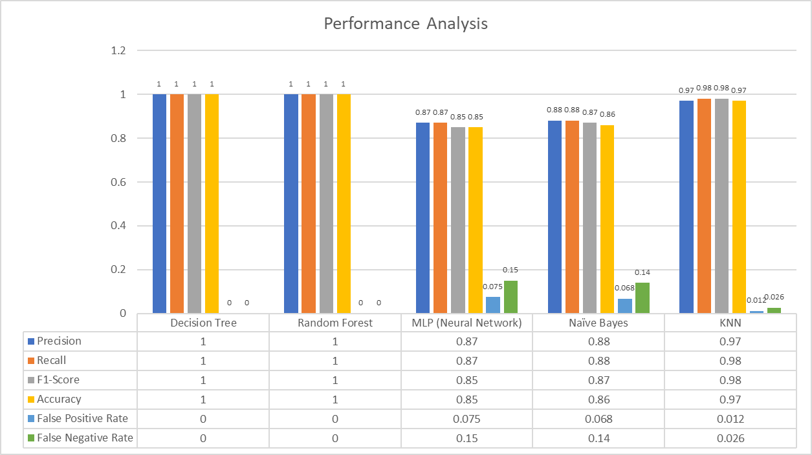
Performance Analysis
Comparison of Machine Learning Models
Metrics: Precision, Recall, F1-Score, Accuracy, False Positive Rate and False Negative rate.
Models: Decision Tree, Random Forest, MLP, Naïve Bayes, KNN.
Key Observations:
Decision Tree and Random Forest models excel across all metrics, showcasing robustness.

Slide 13
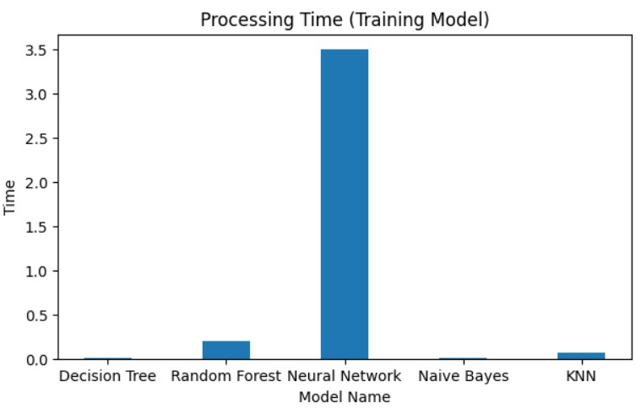
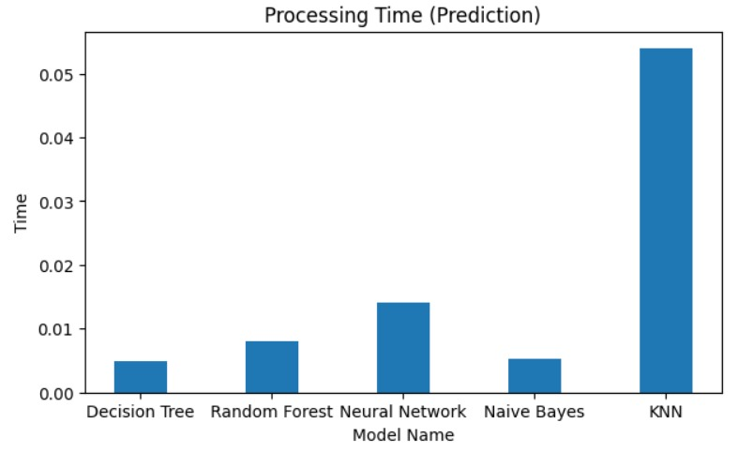
Performance Analysis
Processing Time (Training Model)
Neural Network (NN) Model: Exhibits significantly longer training time (approx. 3.5 seconds) compared to other models.
Decision Tree, Random Forest, Naive Bayes, KNN: Display minimal processing time close to zero, indicating quick training.
Prediction Processing Time
KNN: Most time-consuming
Decision Tree, Random Forest: Swift prediction times (< 0.03 seconds).

Slide 14
Conclusion
Key Insights:
Identified critical feature dimensions influencing IDS classification performance.
Emphasized the importance of meticulous data preprocessing, robust model training, and rigorous performance evaluations.
Feature Selection:
Leveraged Random Forest-based feature reduction to streamline model complexity and improve processing speed.
ML Classifier Evaluation:
Decision Tree and Random Forest models stood out as top performers for detecting SSH and FTP brute force attacks.
Highlighted their high precision, recall, F1-score, and accuracy metrics, showcasing robustness for real-time intrusion detection tasks.
Future Directions:
Suggested exploration of advanced ML techniques, ensemble learning strategies, and real-time threat intelligence integration for enhanced IDS capabilities.
Emphasized the continual refinement and innovation in ML-based IDS to mitigate evolving cyber threats effectively.

Slide 15
References
(PDF) Performance analysis of intrusion detection for deep learning model based on CSE-CIC-IDS2018 dataset. (2020, November 1). ResearchGate. https://www.researchgate.net/publication/360104704_Performance_analysis_of_intrusion_detection_for_deep_learning_model_based_on_CSE-CIC-IDS2018_dataset
(PDF) SSH-Brute Force Attack Detection Model based on Deep Learning. (2023, February 1). ResearchGate. https://www.researchgate.net/publication/348541012_SSH-Brute_Force_Attack_Detection_Model_based_on_Deep_Learning
CanadianInstituteForCybersecurity. (n.d.). GitHub - CanadianInstituteForCybersecurity/CICFlowMeterGitHub. https://github.com/CanadianInstituteForCybersecurity/CICFlowMeter
IDS 2018 | Datasets | Research | Canadian Institute for Cybersecurity | UNB. (n.d.). https://www.unb.ca/cic/datasets/ids-2018.html
patator | Kali Linux Tools. (n.d.). Kali Linux. https://www.kali.org/tools/patator/
Songma, S., Sathuphan, T., & Pamutha, T. (2023). Optimizing intrusion detection systems in three phases on the CSE-CIC-IDS-2018 dataset. Computers, 12(12), 245. https://doi.org/10.3390/computers12120245
Talukder, M. A., Islam, M. M., Uddin, M. A., Hasan, K. F., Sharmin, S., Alyami, S. A., & Moni, M. A. (2024). Machine learning-based network intrusion detection for big and imbalanced data using oversampling, stacking feature embedding and feature extraction. Journal of Big Data, 11(1). https://doi.org/10.1186/s40537-024-00886-w

Slide 16


